Slide 1
Multithreading

Slide 2
Thread
Thread
A single sequence stream within a process.
Possesses same properties as of the process also called as light weight processes
Each thread has
A program counter
Keeps track of which instruction to execute next
A register set
Hold its current working variables
A stack space
Contains the execution history

Slide 3
Thread (contd…)
Threads are not independent, processes are.
Threads are designed to assist each other, processes may or may not do it
Threads share with other threads
Their code section,
Data section, and
OS resources
Similarity between Threads and Processes –
Only one thread or process is active at a time
Within process both execute sequential
Both can create children

Slide 4
Thread (contd…)
Advantages of Thread over Process
Responsiveness
Faster context switch
Effective utilization of multiprocessor system
Resource sharing
Stack and registers can’t be shared among the threads. Each thread has its own stack and registers.
Communication
Enhanced throughput of the system

Slide 5
Thread (contd…)
Multithreading contains two or more threads that can run concurrently.
Each thread defines a separate path of execution. Thus, multithreading is a specialized form of multitasking.
Multiple threads perform multiple tasks within the environment of a single process.
All threads within a single process have access to the same process components, such as file descriptors and memory.
Each process is doing only one thing at a time.
With multiple threads of control, we can design our programs to do more than one thing at a time within a single process.

Slide 6
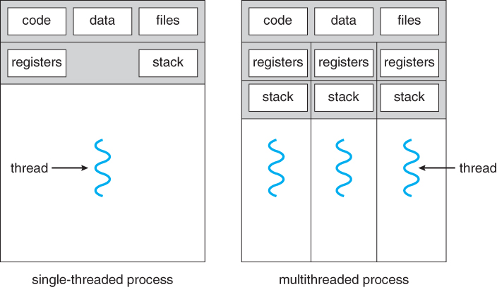
Thread (contd…)
This Photo by Unknown Author is licensed under CC BY-SA

Slide 7
Thread (contd…)
Thread can be implemented by two ways −
User Level Threads (ULT)− User managed threads.
User threads are supported above the kernel and are managed without kernel support
Kernel Level Threads (KLT)
Operating System managed threads acting on kernel.
Each ULT has a process that keeps track of the thread using the Thread table.
Each KLT has Thread Table (TCB) as well as the Process Table (PCB).
Modern operating systems—including Windows, Linux, and macOS— support kernel threads also.

Slide 8
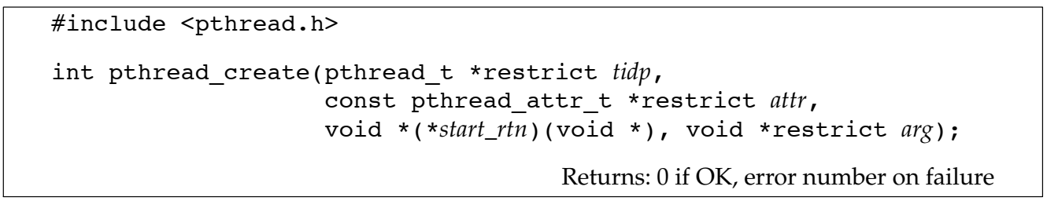
Thread (contd…)
#include <pthread.h>
tidp is set to the thread ID of the newly created thread.
attr argument is used to customize various thread attributes .
The newly created thread starts running at the address of the start_rtn function.
This function takes a single argument,arg, that is a typeless pointer.

Slide 9
Thread (contd…)
When a thread is created, there is no guarantee which will run first: the newly created thread or the calling thread
Just as every process has a process ID, every thread has a thread ID.
New thread obtains its thread ID by calling pthread_self
pid = getpid(); tid = pthread_self();
Threads created within a process, have the same process ID, but different thread IDs.

Slide 10
Thread (contd…)
Thread Termination
The thread can simply return from the start routine. The return value is the thread’s exit code.
The thread can be canceled by another thread in the same process.
The thread can call pthread_exit
The rval_ptr argument is a typeless pointer, similar to the single argument passed to the start routine.

Slide 11
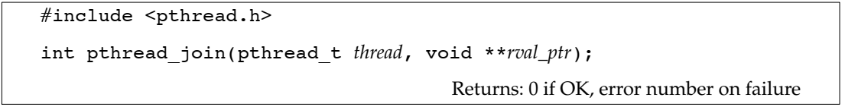
Thread (contd…)
The calling thread will block until the specified thread calls pthread_exit, returns from its start routine.
By default, a thread’s termination status is retained until we call pthread_join for that thread. A thread’s underlying storage can be reclaimed immediately on termination if the thread has been detached. After a thread is detached, we can’t use the pthread_join function to wait for its termination status, because calling pthread_join for a detached thread results in undefined behavior. We can detach a thread by calling pthread_detach.

Slide 12
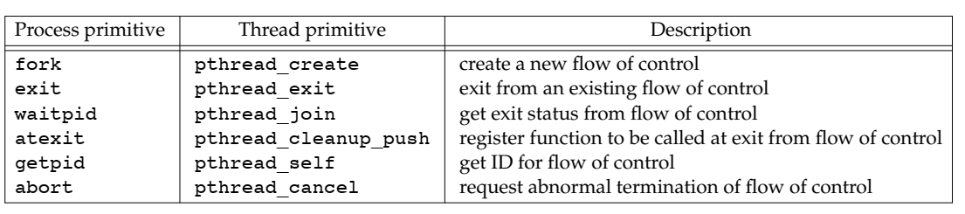
Thread (contd…)

Slide 13
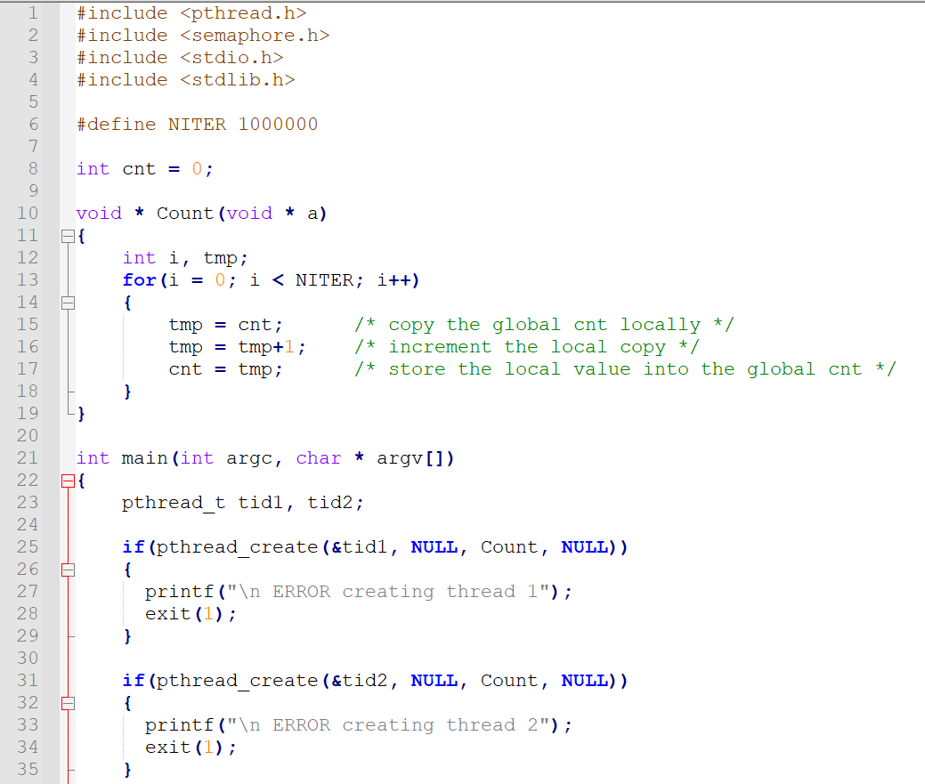
Continued…

Slide 14
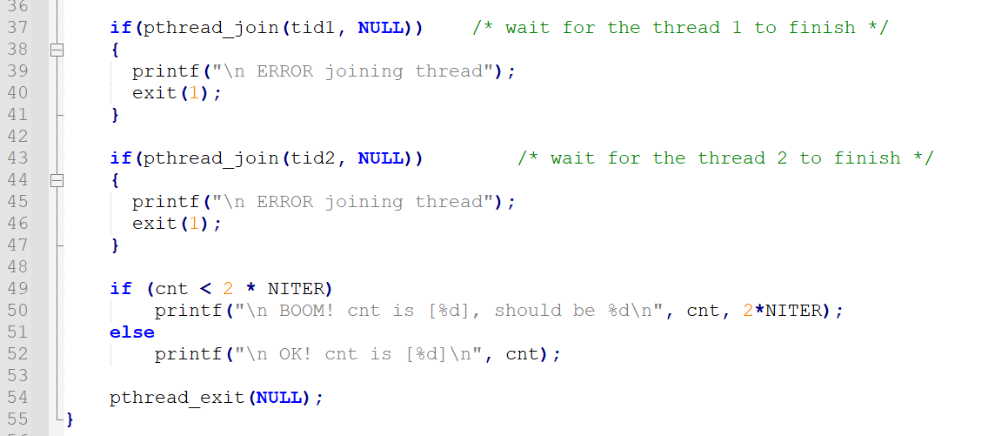
Problem: Value of cnt may not be equal to 2*NITER

Slide 15
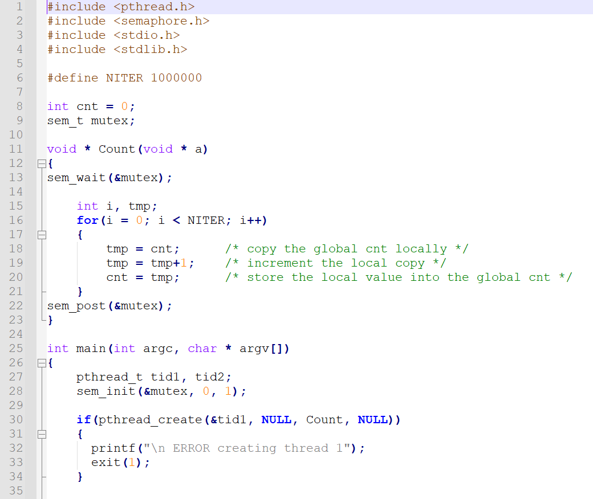
Solution
Use wait and signal
Continued…

Slide 16
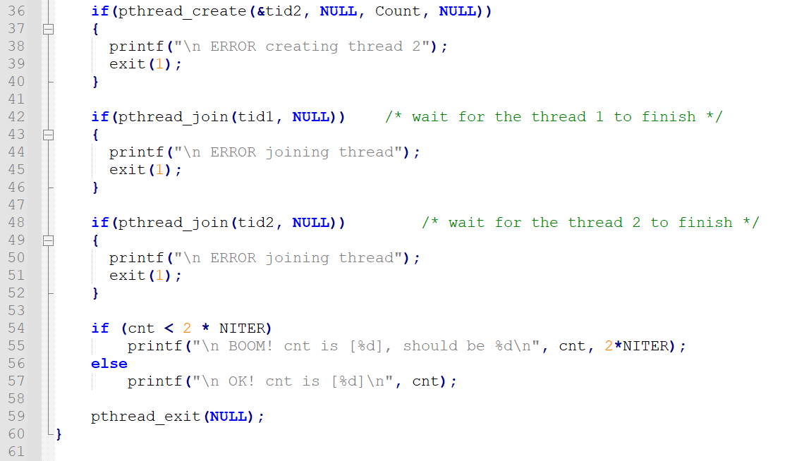

Slide 17
Reference
The Design of the UNIX Operating System, by Maurice J. Bach
Advanced Programming in the UNIX ® Environment, by W. Richard Stevens, Stephen A. Rago

